Slide 1

DISASTER TWEET CLASSIFICATION USING MACHINE LEARNING
MOHAMED RAYYAN M
B.TECH AI&DS -‘B’ SECTION

Slide 2
ABOUT THE COMPANY
Brief Overview of the organization : Mission and vision
SkillForge is a leading e-learning company specializing in Data Science, Artificial Intelligence, and Machine Learning training programs.
It focuses on hands-on projects to bridge the gap between academic concepts and industrial applications.
Mission: To deliver project-based learning that transforms students into data-driven professionals equipped with analytical and technical skills.
Vision: To empower learners with real-world AI experience through guided internships and mentorship-driven education.
Key Services / Products:
Data Science & AI Training
Python-based Machine Learning Projects
Internship Certification & Mentorship Programs
Core Expertise:
Data Analytics & Visualization, NLP and AI systems
Machine Learning & Deep Learning

Slide 3
ABOUT THE INTERNSHIP
To gain hands-on experience in Machine Learning and Natural Language Processing (NLP) through real-time data analysis.
To understand the complete data science workflow — data collection, preprocessing, feature extraction, model building, and evaluation.
To bridge the gap between academic learning and industrial practices by applying Python and ML techniques on a live dataset.
To acquire an understanding of how machine learning solutions are used to address real-world problems like disaster detection from tweets.
1.Learning Objectives:
2.Personal Goals & Professional Growth:
Strengthened expertise in Python programming, data handling, and ML model development.
Improved problem-solving skills through practical experimentation with multiple algorithms (Logistic Regression, Naïve Bayes, KNN).
Developed the ability to analyze, interpret, and visualize large text-based datasets effectively.
Gained confidence to apply machine learning concepts in real-time projects and pursue a career in data analytics and AI.

Slide 4
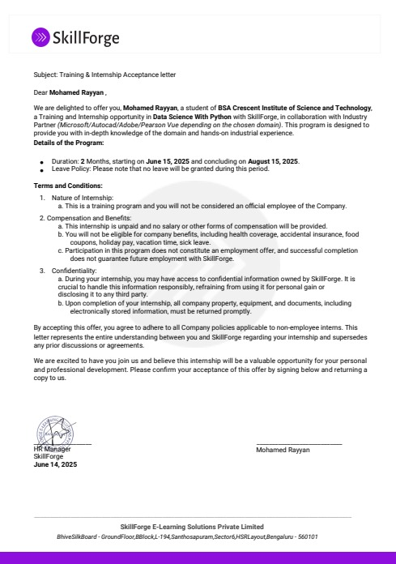
INTERNSHIP OFFER LETTER

Slide 5
ROLES AND RESPONSIBILITIES
Analyzed and understood the disaster tweet dataset for classification.
Cleaned and preprocessed tweets using NLP and text-cleaning techniques.
Performed tokenization, stemming, and stop-word removal for uniform text.
Converted processed text into numerical features using TF-IDF and CountVectorizer.
Implemented machine-learning models including Logistic Regression, Naïve Bayes, and KNN.
Evaluated model performance using accuracy, precision, recall, and F1-score.
Compared algorithms to identify the most effective classification model.
Visualized data distributions and results using Matplotlib and Seaborn.
Documented methodology, code, and results in a structured project report.
Collaborated with mentors to enhance technical and professional skills.

Slide 6
ABOUT WORK / PROJECTS
PROJECT 1 Disaster Tweet Classification
Objective: To develop a machine learning model capable of classifying tweets as disaster-related or non-disaster using text data analysis and NLP techniques. Tools & Technologies: Python, NLTK, Scikit-learn, TF-IDF, Matplotlib
Key Task: Performed data cleaning, preprocessing, and tokenization. Applied stemming and removed noise such as URLs, emojis, and special characters. Converted text to numerical features using CountVectorizer and TF-IDF. Trained multiple ML models like Logistic Regression, Naïve Bayes, and KNN. Evaluated accuracy and performance metrics to select the best model.
Challenges Faced & Solutions Implemented: Noisy Text Data: Hashtags & links → Applied regex cleaning and stemming. Sparse Features: High-dimensional text → Used TF-IDF Vectorization. Model Accuracy: Inconsistent results → Finalized TF-IDF + Logistic Regression (85%).

Slide 7
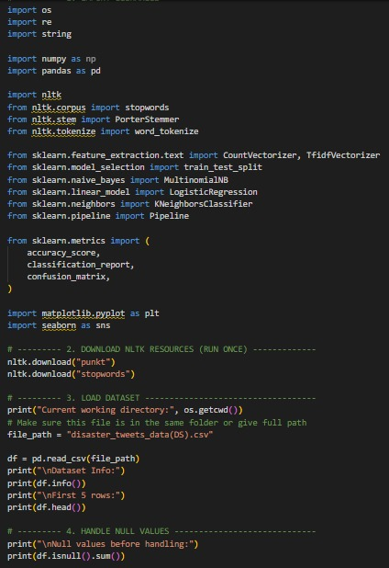
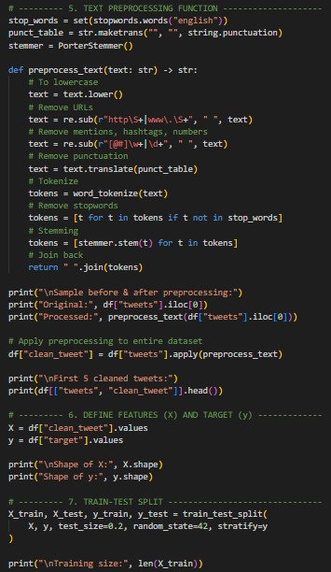
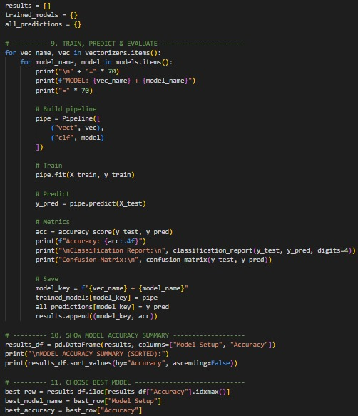
  SOURCE CODE
DISASTER TWEET CLASSIFICATION

Slide 8
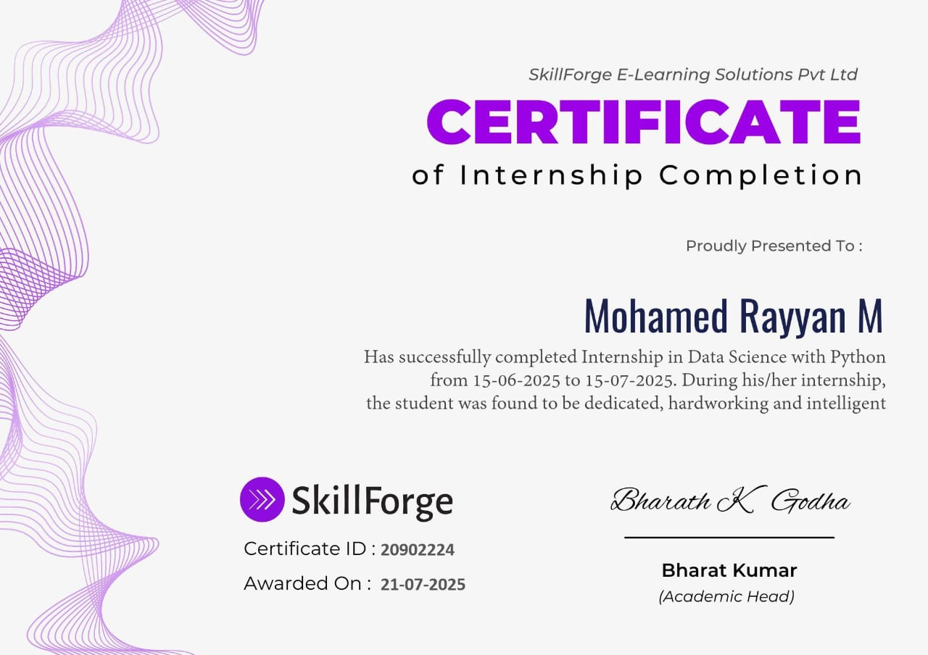
INTERNSHIP CERTIFICATE

Slide 9
CONCLUSION
1. Summary of Overall Experience:
Gained strong practical exposure to Machine Learning and NLP through the Disaster Tweet Classification project.
Enhanced technical, analytical, and problem-solving skills by implementing end-to-end data science workflows.
Developed better professional communication, documentation, and project presentation abilities through mentor guidance.
2. Future Applications of Knowledge Gained:
Can be applied to real-time social media monitoring for detecting and responding to disaster events quickly.
The NLP and ML concepts learned can be extended to sentiment analysis, spam detection, and emergency response systems.
Provides a foundation for developing advanced AI models like BERT or deep learning-based text classifiers for higher accuracy.
3. Expression of Gratitude:
Heartfelt thanks to SkillForge Pvt. Ltd. for the valuable internship opportunity.
Sincere gratitude to Mrs. R. Sivasankari, Faculty Mentor, for her constant guidance and support.
Appreciation to all SkillForge mentors and Crescent faculty for their encouragement throughout the project journey.
i

